Slide 1


Competitor Analysis
A comparative overview of competing body composition analyzers, key features, and competitive gaps.
Clinical Workshop
InBody India · 2026

Slide 2
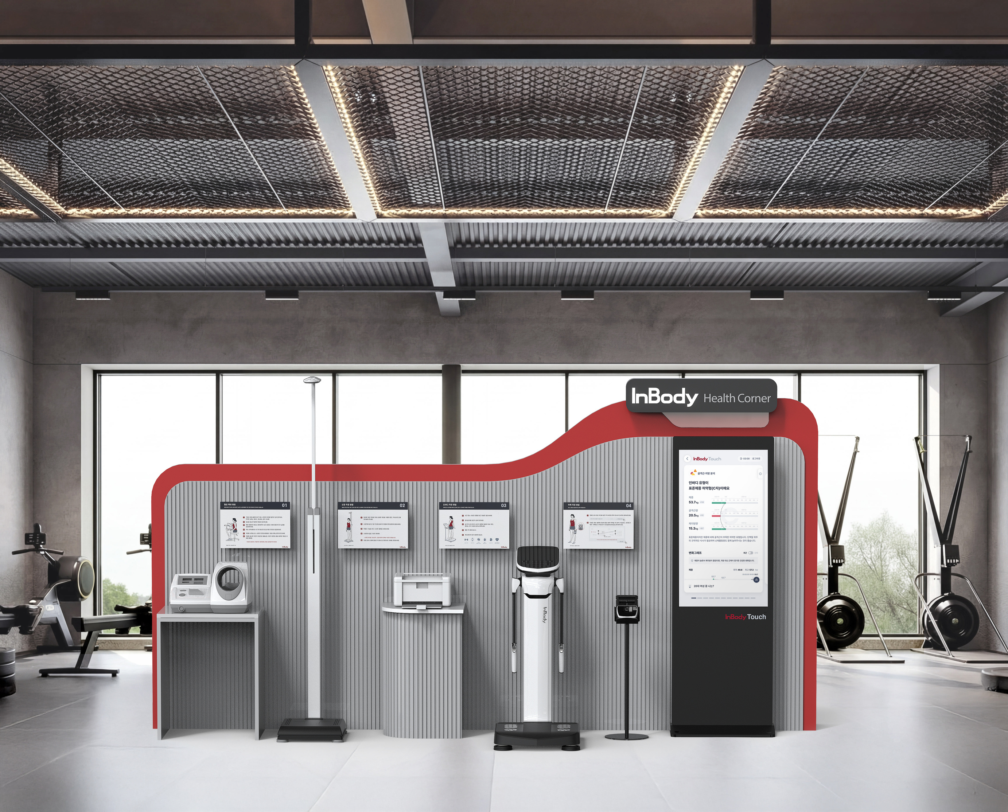
Tanita
Tanita has a broad product range, from professional segmental analyzers such as the MC-980MA Plus to portable and consumer body composition monitors
01
Empirical estimation
Values are calculated from prediction equations built on reference groups, so accuracy can drop for people who differ from those groups (athletes, elderly, patients with fluid shifts).
01
No validation research or full certification shown
Accuracy studies are not shown , and certification is blank for SOme of there products.
01
Limited frequency options in selected models
The MC-780MA uses three frequencies, compared with six in the MC-980MA Plus.
01
Limited frequency options in selected models
The MC-780MA uses three frequencies, compared with six in the MC-980MA Plus.

Slide 3
Accuniq
ACCUNIQ models mainly differ in measurement technology, detailed body composition analysis, report features and connectivity.
01
-
BC310, BC300 & i35 have fewer frequencies ; lacks ’s phase-angle and detailed water-analysis features. Mobile-app, QR-code and cloud-dashboard features are not listed as supported.
01
-
Hand-grip electrodes contact may be more sensitive to inconsistent hand positioning or grip, potentially affecting measurement reproducibility if contact is poor.
01
-
Models do not use3 MHz measurement; therefore, they lack this additional high-frequency measurement capability
01
-
BC300, BC310, BC380 and i35 do not provide BC720’s specific segmental ICW, ECW and ECW/TBW. W and ECW/TBW.

Slide 4
Bodystat
Bodystat offers BIS devices. Its Multiscan 5000 is a portable BIS analyzer, while other devices offer more basic measurements.
01
Supine measurement procedure
The subject needs to lies down for testing, unlike a standing analyzer workflow.
01
BIS Technology
Uses Bioelectrical Impedance Spectroscopy (BIS) rather than InBody’s Direct Segmental Multi-Frequency BIA (DSM-BIA) approach.
01
Single-Side Measurement
Uses a handheld electrode configuration with measurements taken through one side of the body, rather than InBody’s 8-point tactile electrode system.
01
Limited Segmental Assessment
Does not provide the same direct, separate measurements of both arms, both legs and the trunk as InBody’s segmental measurement approach. The handheld workflow requires separate weight entry and does not provide the same integrated standing, segmental body composition assessment.

Slide 5
Mediana
Mediana models vary in measurement frequencies, segmental analysis and connectivity
01
-
The i20, i25, i30 and i35 do not provide the full cellular analysis and phase angle capabilities available in the i50/i55.
01
-
Mediana i20–i35 specifications do not list segment-by-segment ICW and ECW analysis, unlike the i50/i55, which provide detailed segmental body-water distribution.
01
-
The Mediana i20 and i25 have a 4.3-inch screen, compared with the 7-inch screens on the i30 and i35. This provides less screen space for viewing results and navigating menus
01
-
The Mediana i20 measures at only 10 and 100 kHz, compared with the i50’s six frequencies (1, 5, 50, 100, 250 and 500 kHz). Fewer frequencies limit detailed fluid-distribution analysis.

Slide 6
Seca
Seca mBCA models differ in measurement position (standing or lying down), measurement frequencies, clinical validation, and workflow
01
-
The mBCA 555 uses a 4.3-inch touchscreen, smaller than the 7-inch display on the mBCA 525, less screen space for viewing results.
01
-
Does not list segmental ECW/TBW or segmental Phase Angle, which help assess regional fluid imbalance and cell health
01
-
The mBCA 554 requires an optional ultrasonic height-measurement accessory for automatic height measurement; without it, height must be obtained separately
01
-
The mBCA 514 and 525 use seca analytics 115 PC software, while the mBCA 554 uses cloud-based seca analytics 125. This means the reporting workflow and software requirements vary by model

Slide 7
Impedimed
ImpediMed's SOZO is a bioimpedance spectroscopy (BIS) system focused particularly on fluid status and clinical monitoring.
01
No segmental body composition analysis
The SOZO product brief does not specify separate arm, leg and trunk body composition results.
01
Different primary clinical focus
Its L-Dex and Hy-Dex features are particularly relevant to lymphoedema and fluid monitoring, so comparisons should account for the intended clinical application.
01
Limited frequency options in selected models
Dependence on a separate tablet interface: The listed configuration uses a Samsung Galaxy Tab A tablet.
01
Cloud and Wi-Fi-dependent
Results run through a cloud platform on a tablet; no standalone PC software is listed.

Slide 8

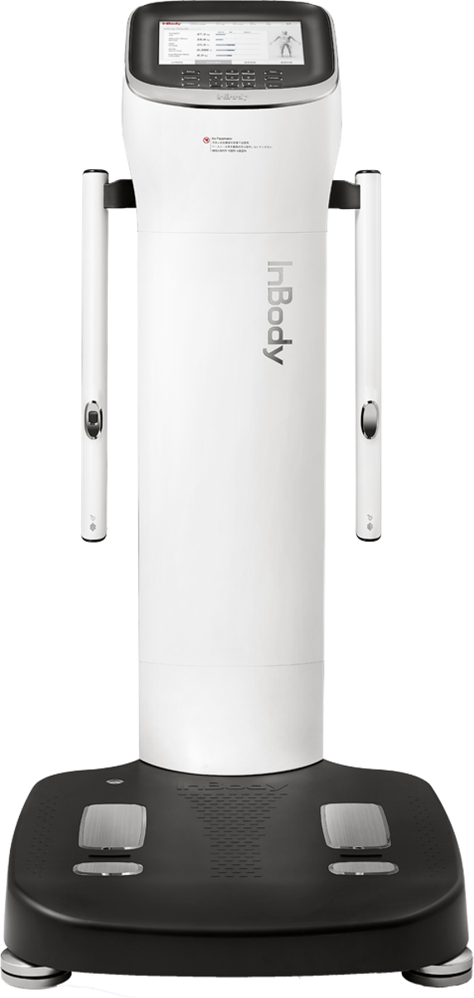
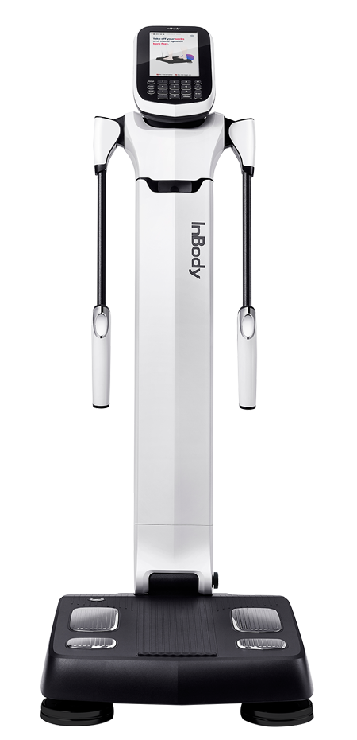

Thank You

